Slide 1
Indoor Wi-Fi Locationing and Evaluation Technique Using Machine Learning Algorithm
BY
AKANO, K. K
DATA ANALYST

Slide 2
AGENDA
DESCRIPTION OF THE DATASET
AIM AND CHALLENGES
PREPROCESSING
NearZeroVar
Principle Component Analysis
Normalization
DATA VISUALIZATION OF THE DATASET
EVALUATION OF MODEL USING REGRESSION AND CLASSIFICATION
PREFORMANCE METRIC RESULTS
CONCLUSION

Slide 3
DESCRIPTION OF THE DATASET
The data is a multivariate containing two datasets: Training Dataset with 13958 observation and 529 variable and Validation dataset with 1111 observations and 529 variables containing dependent variables like Longitude, Latitude , Altitude(Floor, Building, relative position etc) and WAPs independent variables. Its important to know that the integer in the observation varies from Negative to positive, where negative values ranges from -104 to 0, indicting 0 as the strongest signal and positive value 100 indicates the WAP detects no signal.
The datasets visual shows three buildings located in Jaume University located in Spain with different floors of areas almost 110.000 square meters.
The data was collected from UCI Machine learning repositories and downloaded in my R-studio for Preprocessing, Data Visualization, Evaluation and Modeling.

Slide 4
AIM AND CHALLENGE
The main aim is to be able to locate number of person in building using wi-fifootprinting in order to show position on a environment and be able to give some instructions to move inside the building.
CHALLENGE
How to reduce, transform and standardized the features in the dataset.

Slide 5
PREPROCESSING
I separated the data into dependent and independent dataset for easy preprocessing and joined it back after the processing. Longitude, latitude, and altitude are the only values I need in order to locate someone.
I used NearZeroVar in caret package, Principle component analysis and normalize function for scaling the datasets.

Slide 6
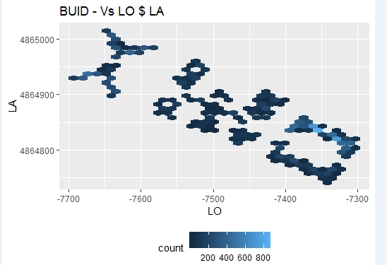
DATA VISUALIZATION
Ggplot package : BU Vs LO and LA

Slide 7
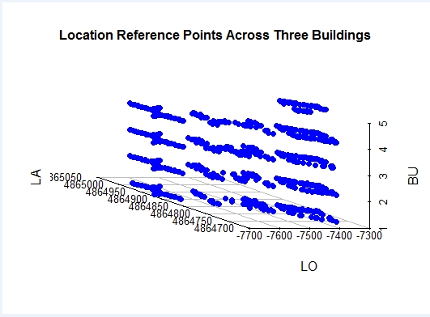
DATA VISUALIZATION
Scatteredplot3d : FL , LO and LA coordinates

Slide 8
MODELING EVALUATION
Regression Model : Longitude and Latitude: Predictive modeling technique which investigates the relationship between a dependent (target) and independent variable (s) (predictor).
Weighted KKNN,
Random Forest
SVM algorithm
Classification Model : Floor and Building: Predictive model used for categorical class label based on the training set and values in classifying attributes.
Random Forest
SVM
C5.0 algorithm

Slide 9
PERFORMANCE METRIC RESULTS
REGRESSION MODEL
LONGITUDE LATITUDE
Kknn : Kknn:
MAE : 3.8 MAE: 2.710
MSE: 84.0 MSE: 59.61
RMSE: 9.0 RMSE: 7.61
MAPE: 0.004 MAPE: 0.005
RF: RF:
MAE: 4.703 MAE: 3.7
MSE: 89.52 MSE: 53.5
RMSE: 8.93 RMSE: 6.8
MAPE: 0.001 MAPE: 0.007
SVM: SVM
Mean Absolute Error: 8.90 Mean Absolute Error: 5.8
Mean Square Error: 147.6 Mean Square Error: 72.8
Root Mean Square Error: 11.9 Root Mean Square Error: 8.7
MAPE : 0.09

Slide 10
PERFORMANCE METRIC RESULTS
CLASSIFICATION MODEL
FLOOR BUILDING
RF: RF
Accuracy : 0.9981 and Kappa : 0.9975 Accuracy: Accuracy : 0.9945 and Kappa : 0.9936
Misclassification Error: 0.031 Error -- 0.005
SVM: SVM
Accuracy : 0.9686 and Kappa : 0.9593 Accuracy : 0.9975 and Kappa : 0.9961
Misclassification error: 0.3144865 Error -- 0.0025
C50: C50
Accuracy: 0.8976 and Kappa : 0.8675 Accuracy : 0.996 and Kappa: 0.994
Misclassification Error --- 0.102 Error --- 0.003846797

Slide 11
CONCLUSION
The best Model used in Classification in both Floor and Building are:
Floor: RF
Building: SVM
Reasons: Good Accuracy and less Error
Regression:
Longitude: KKNN
Latitude: RF
Reasons: The Higher the MSE the worse the model becomes because higher values indicts weak model.

